Slide 1

Dolphin: A Programmable Framework for Scalable Neurosymbolic Learning
Aaditya Naik, Jason Liu, Claire Wang, Amish Sethi,
Saikat Dutta, Mayur Naik, Eric Wong

Slide 2
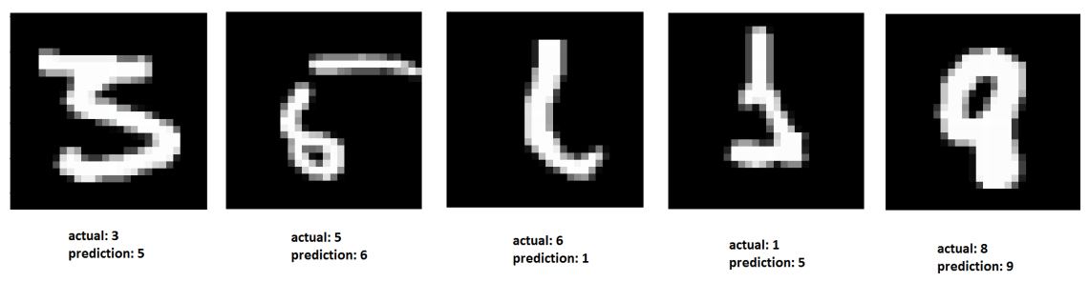
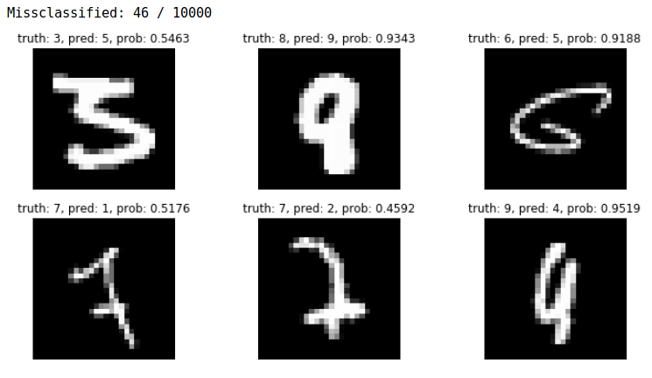
Neurosymbolic Training
Example Problem: MNIST Sum-2
+
12

Slide 3
Neurosymbolic Training
Example Problem: MNIST Sum-2
12
Needs large amount of labelled data
Lacks generalizability
Poor interpretability

Slide 4
Neurosymbolic Training
Example Problem: MNIST Sum-2
0
1
…
9
p₀
p₁
…
p₉
Symbolic
Program
0
1
…
18
p’’₀
p’’₁
…
p’’₁₈
0
1
…
9
p’₀
p’₁
…
p’₉
Perception
Reasoning

Slide 5
Neurosymbolic Training
Example Problem: MNIST Sum-2
Label 12
0
1
…
9
p₀
p₁
…
p₉
Symbolic
Program
0
1
…
18
p’’₀
p’’₁
…
p’’₁₈
0
1
…
9
p’₀
p’₁
…
p’₉
Backpropagation

Slide 6
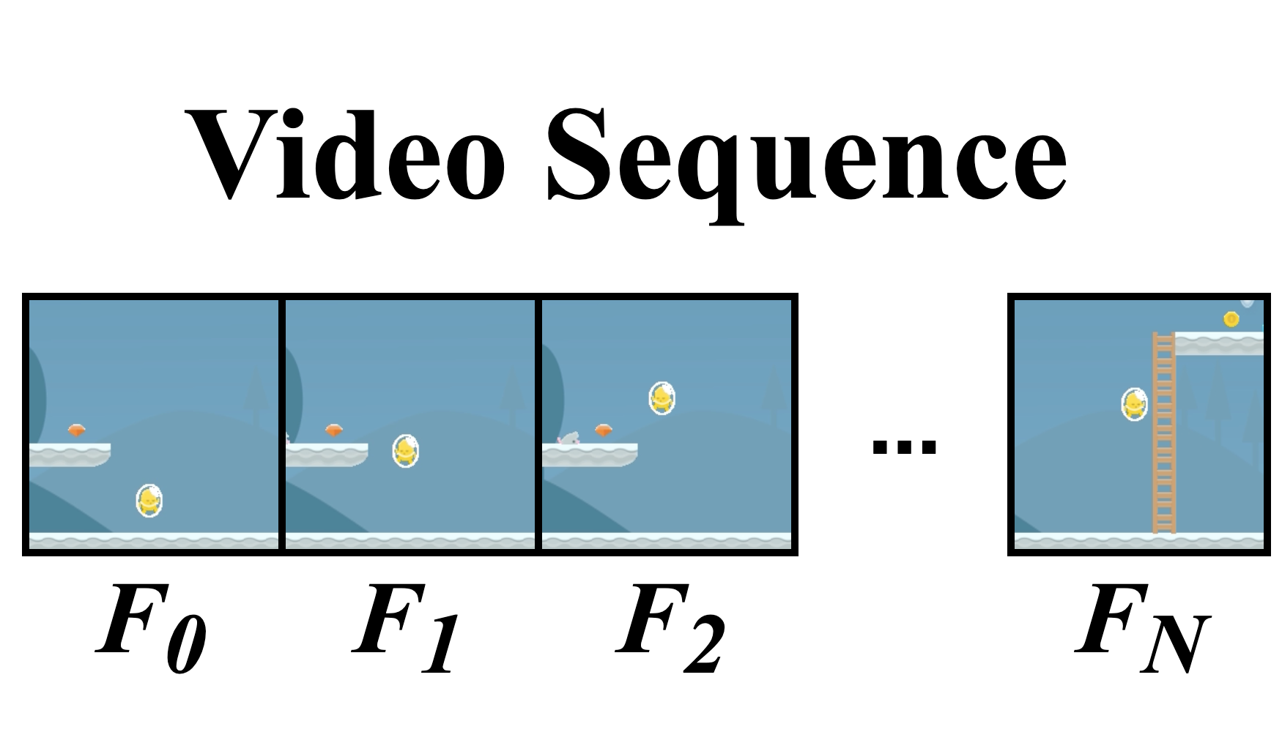
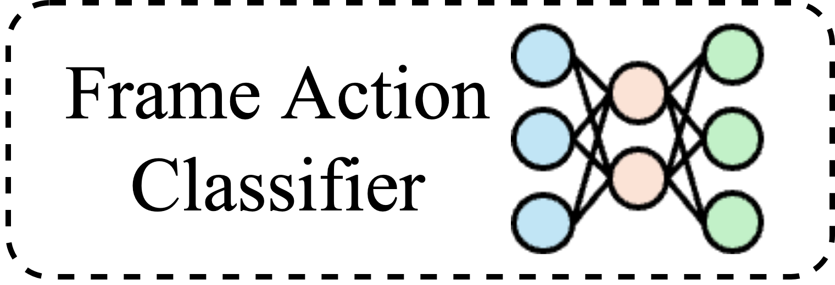
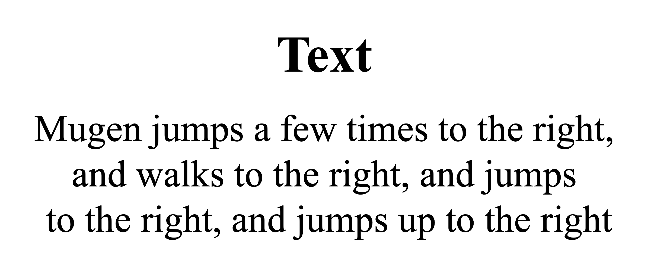
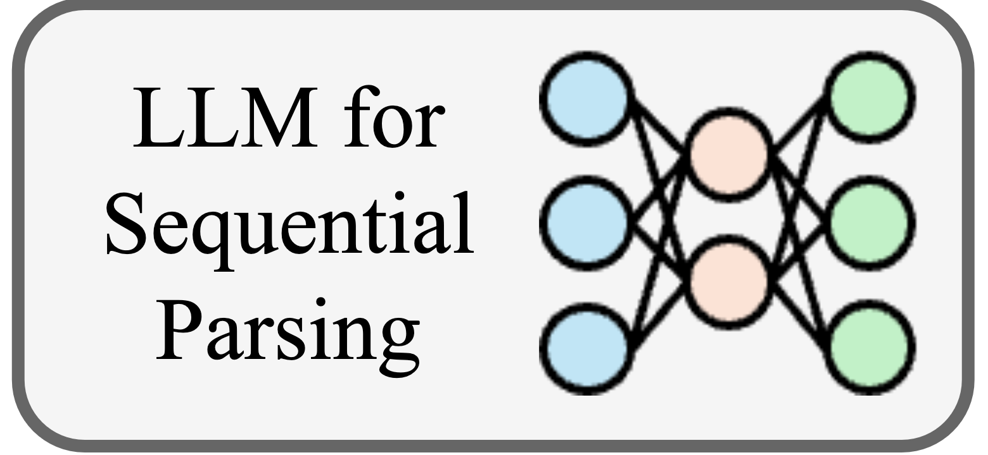
Neurosymbolic Training
Example Problem: Video-Text Alignment (MUGEN)
Symbolic
Program
Aligned

Slide 7
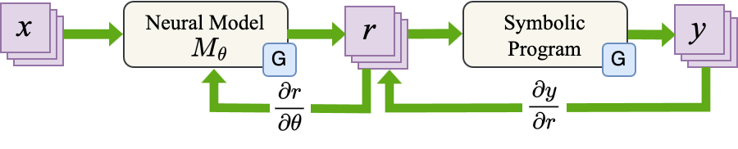
Neurosymbolic Frameworks
Runs the Symbolic Program entirely on the GPU
GPU
GPU
e.g. Logic Tensor Networks

Slide 8
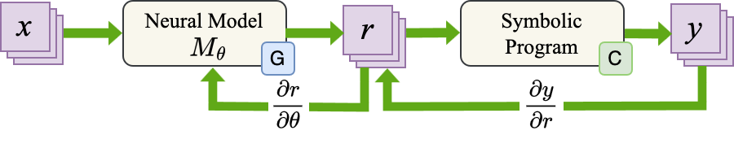
Neurosymbolic Frameworks
Runs the Symbolic Program entirely on the CPU
GPU
CPU
e.g. Scallop, DeepProbLog

Slide 9
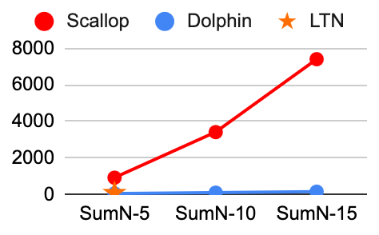
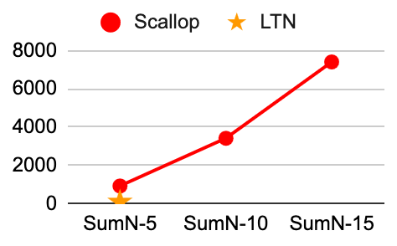
Neurosymbolic Systems don’t Scale
MNIST Sum-N
Purely GPU Frameworks e.g. LTN
Constrainted by GPU Memory
Purely CPU Frameworks e.g. Scallop
Limited Parallelization on the CPU
Lack of Batched Computations
Task Complexity

Slide 10
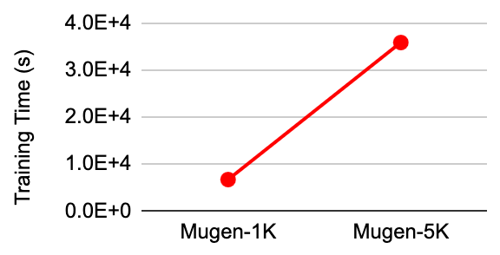
Neurosymbolic Systems don’t Scale
MUGEN
Purely GPU Frameworks e.g. LTN
Constrainted by GPU Memory
Purely CPU Frameworks e.g. Scallop
Limited Parallelization on the CPU
Lack of Batched Computations
Dataset Size

Slide 11
How to Scale Neurosymbolic Training?
Reformulate neurosymbolic computations for the GPU
Easily interface with existing Deep Learning pipelines
Optimize the memory overhead on the GPU

Slide 12
Our Solution: Dolphin
+
+
+
+
…
+
+
+
…
+
+
…
Split the computations between the CPU and GPU: Symbols on the CPU, Probabilities on the GPU
Represent probabilities as PyTorch tensors and vectorize computations over them
Only need one set of CPU computations for the whole batch
Tuples of N MNIST Images
MNISTNet
Probabilities P₁
Probabilities P₂
Probabilities P_{N}
P₁⁰
P₁¹
…
P₁⁹
P₂⁰
P₂¹
…
P₂⁹
…
P_{N}⁰
P_{N}¹
…
P_{N}⁹
L₁⁰
L₁¹
…
L₁⁹
L₁⁰
L₁¹
…
L₁⁹
L₁⁰
L₁¹
…
L₁⁹
L₁⁰
L₁¹
…
L₁⁹
L₁⁰
L₁¹
…
L₁⁹
L₁⁰
L₁¹
…
L₁⁹
Distribution D₁
Distribution D₂
Distribution D_{N}
0
1
…
9
0
1
…
9
…
0
1
…
9
P₁⁰
P₁¹
…
P₁⁹
P₂⁰
P₂¹
…
P₂⁹
P_{N}⁰
P_{N}¹
…
P_{N}⁹
L₁⁰
L₁₁
…
L₁⁹
L₁⁰
L₁₁
…
L₁⁹
L₁⁰
L₁₁
…
L₁⁹
L₁⁰
L₁₁
…
L₁⁹
L₁⁰
L₁₁
…
L₁⁹
L₁⁰
L₁₁
…
L₁⁹
apply, +
…
apply, +
Probabilities P_{Res}
Distribution D_{Res}
P⁰
P¹
…
P^{9N}
0
1
…
9N
L⁰
L¹
…
L^{9N}
L⁰
L¹
…
L^{9N}
P⁰
P¹
…
P^{9N}
L⁰
L¹
…
L^{9N}
L⁰
L¹
…
L^{9N}

Slide 13
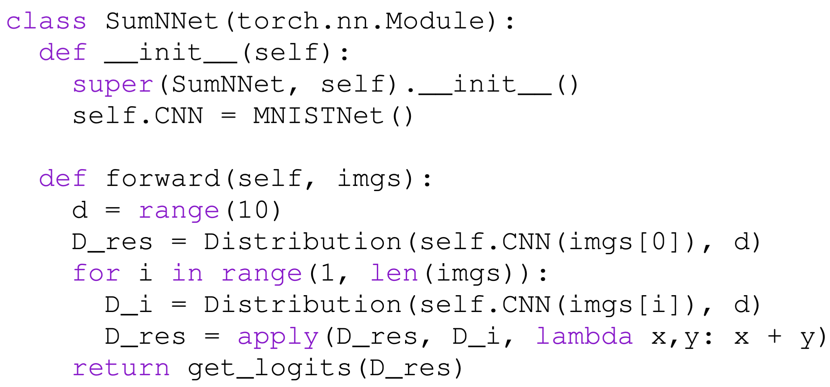
Writing a Dolphin Program
+
+
+
Sum = 53
Tight integration with PyTorch
+
…
+
+
+
+
+
…
+
…
+
+
+
+
+
…
…
Intuitive Pythonic primitives
Support for recursion, control-flow, and blackbox functions
GPU-driven vectorized probabilistic computations

Slide 14
The apply function
D_{Res} = apply(D₁, D₂, f)
f = lambda x, y : x + y
Distribution D₁
Distribution D₂
D_{map} = map(D₁, D₂, f)
S
0
1
…
9
S’
0
1
…
9
f(0,0)
f(0, 1)
…
f(9, 9)
f(S x S’)
p₀₀
p₀₁
…
p₀₉
p’₀₀
p’₀₁
…
p’₀₉
p₀₀ ∧ p’₀₀
p₀₀ ∧ p’₀₁
…
p₀₉ ∧ p’₀₉
p₁₀
p₁₁
…
p₁₉
p’₁₀
p’₁₁
…
p’₁₉
p₁₀ ∧ p’₁₀
p₁₀ ∧ p’₁₁
…
p₁₉ ∧ p’₁₉
…
…
…
p_{b0}
p_{b1}
…
p_{b9}
p’_{b0}
p’_{b1}
…
p’_{b9}
p_{b0} ∧ p’_{b0}
p_{b0} ∧ p’_{b1}
…
p_{b9} ∧ p’_{b9}

Slide 15
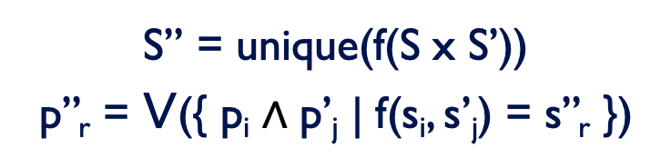
The apply function
D_{Res} = apply(D₁, D₂, f)
f = lambda x, y : x + y
D_{map} = map(D₁, D₂, f)
D_{Res} = reduce(D_{map})
f(S x S’)
f(0,0)
f(0, 1)
…
f(9, 9)
0
1
…
18
S’’
p₀₀ ∧ p’₀₀
p₀₀ ∧ p’₀₁
…
p₀₉ ∧ p’₀₉
p’’₀₀
p’’₀₁
…
p’’₀₉
p₁₀ ∧ p’₁₀
p₁₀ ∧ p’₁₁
…
p₁₉ ∧ p’₁₉
p’’₁₀
p’’₁₁
…
p’’₁₉
…
…
p_{b0} ∧ p’_{b0}
p_{b0} ∧ p’_{b1}
…
p_{b9} ∧ p’_{b9}
p’’_{b0}
p’’_{b1}
…
p’’_{b9}
S’’ = unique(f(S x S’))
p’’_{r} = $∨$({ p_{i} ∧ p’_{j} | f(s_{i}, s’_{j}) = s’’_{r} })

Slide 16
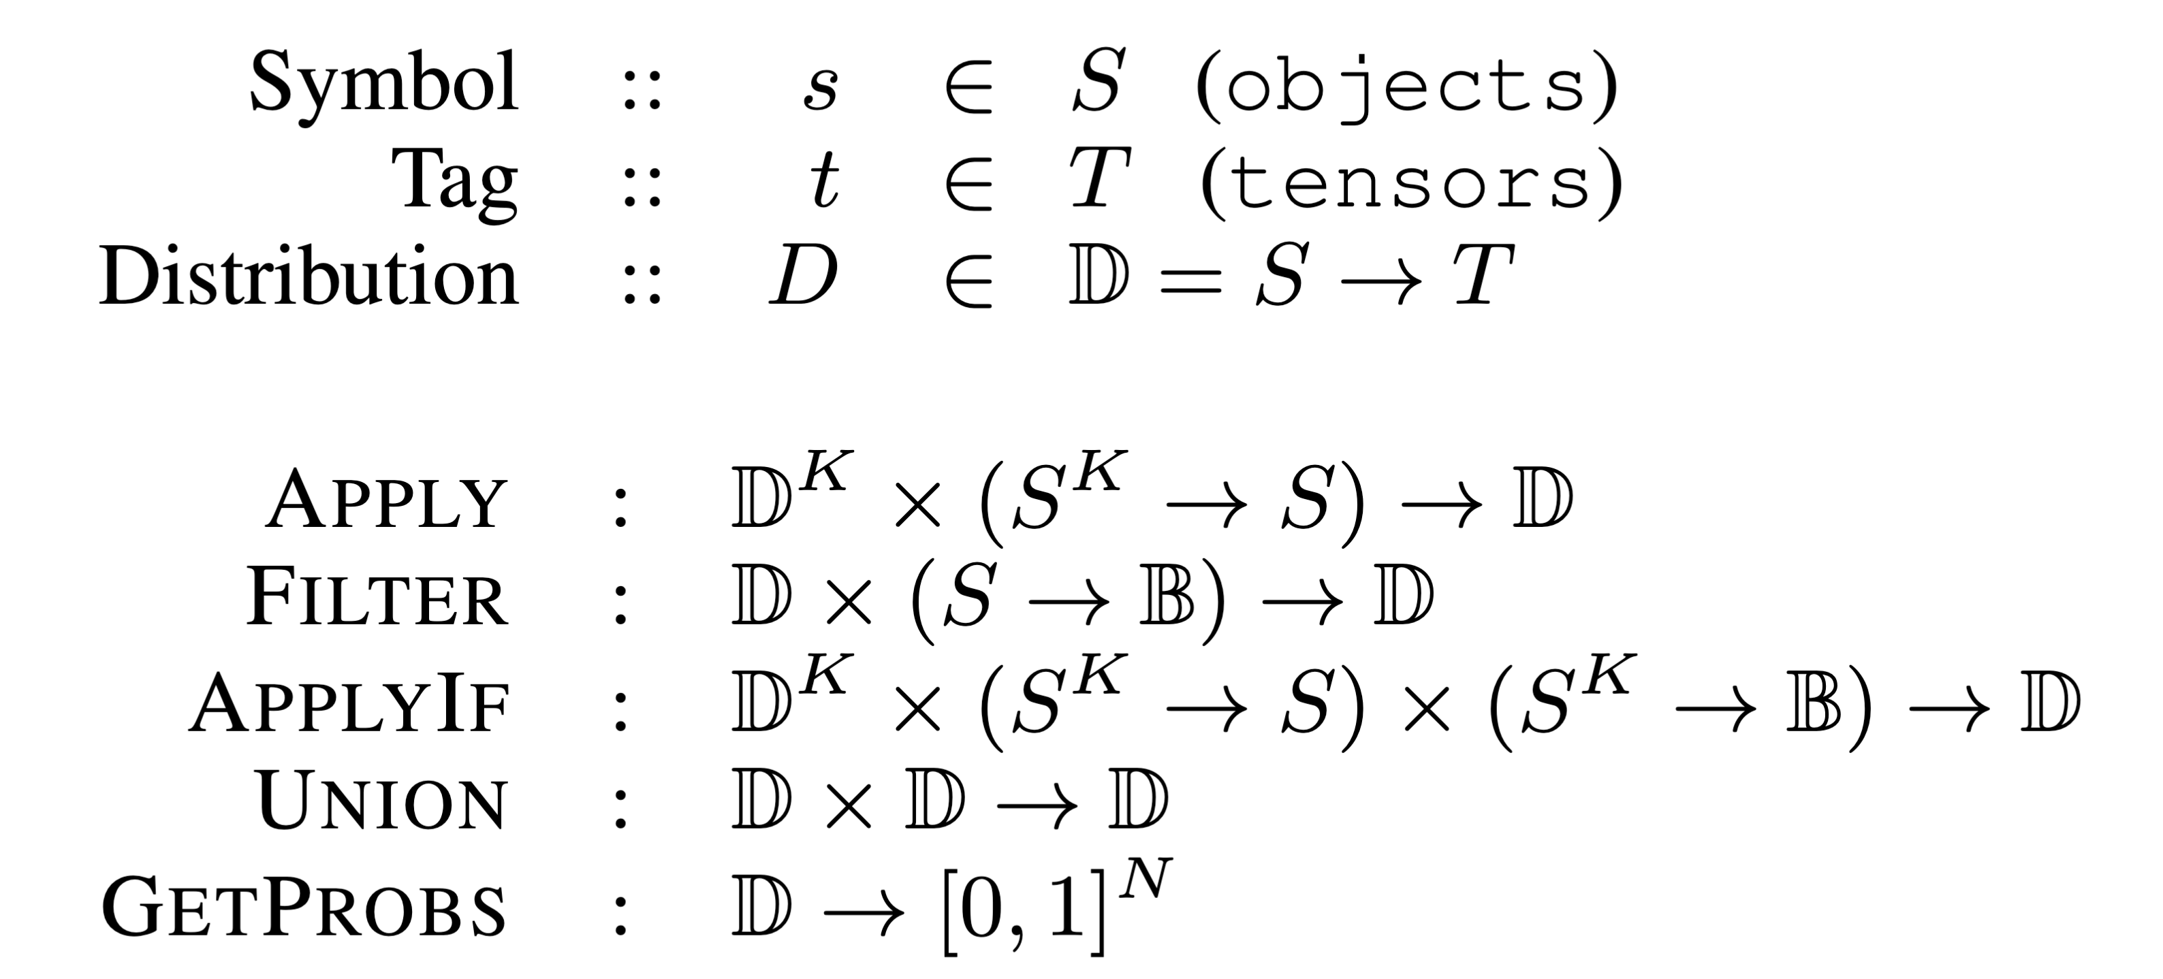
Other Dolphin Primitives - Filter
Filter takes a Boolean function and returns a Distribution with only the symbols that satisfy the function.
D = Distribution(self.CNN(img))
D_{Res} = filter(D, lambda x: x % 2 == 0)

Slide 17
Other Dolphin Primitives - ApplyIf
ApplyIf performs the Apply operation if a condition is satisfied.
D₁ = Distribution(self.CNN(img[0]))
D₂ = Distribution(self.CNN(img[0]))
D_{Res} = filter(D₁, D₂,
func = lambda x, y: x * y / 2 == 0,
cond = lambda x, y: x % 2 == 0)

Slide 18
Other Dolphin Primitives - Union
Union merges the symbols from the two input distributions. Probabilities of common symbols are disjuncted.
D₁ = Distribution(self.CNN(img[0]))
D₂ = Distribution(self.CNN(img[0]))
D_{Res} = union(D₁, D₂)

Slide 19
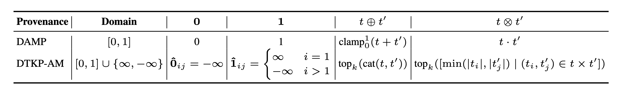


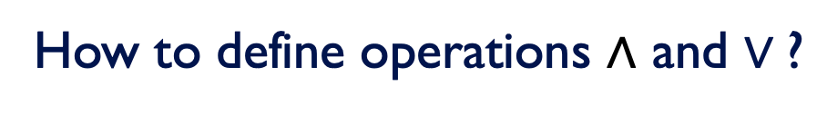
Provenances
How to define operations ∧ and $∨\text{?}$

Slide 20
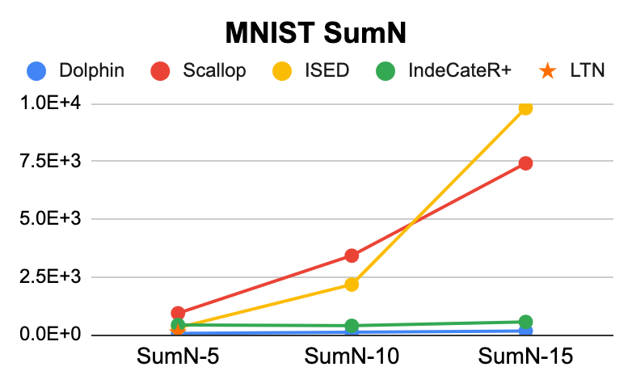

Evaluation Results – Time till Convergence
Input Example

Slide 21
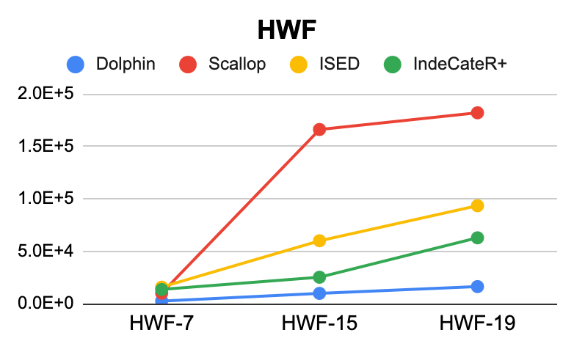
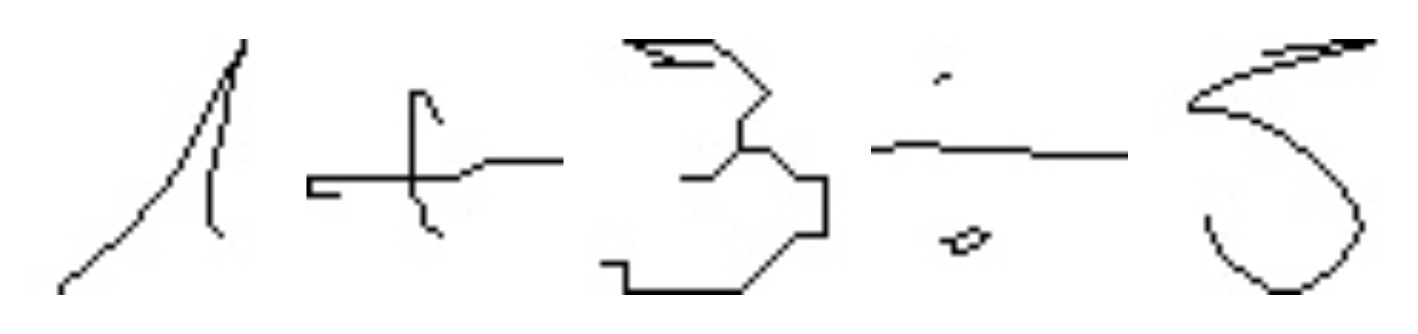
Evaluation Results – Time till Convergence
Input Example

Slide 22
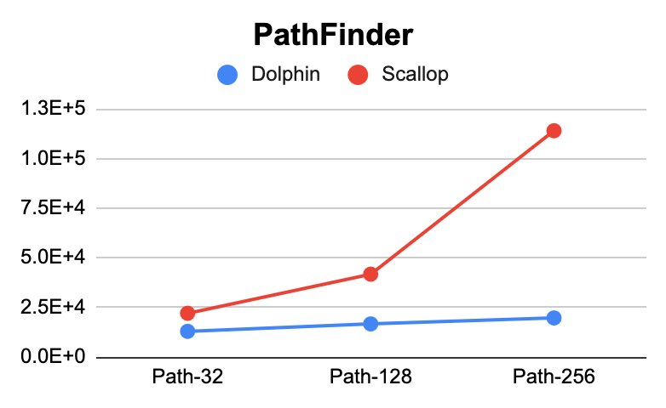
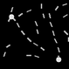
Evaluation Results – Time till Convergence
Input Example

Slide 23
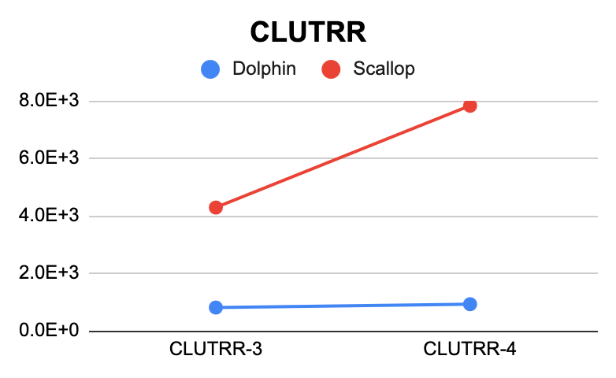
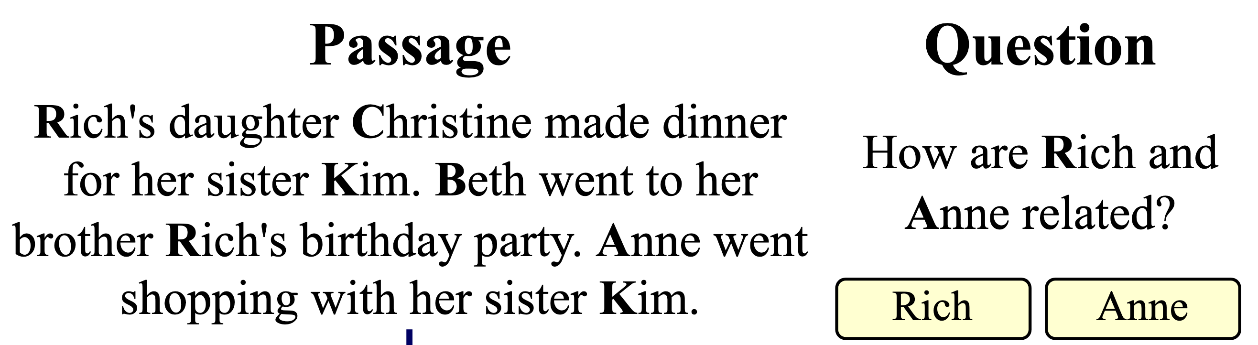
Evaluation Results – Time till Convergence
Input Example

Slide 24
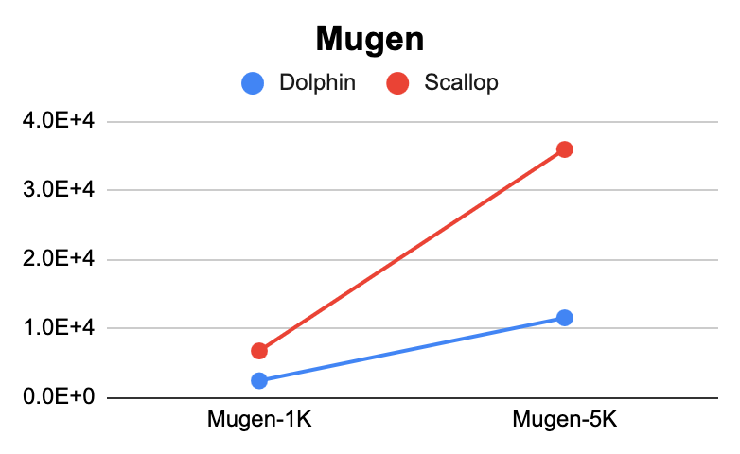
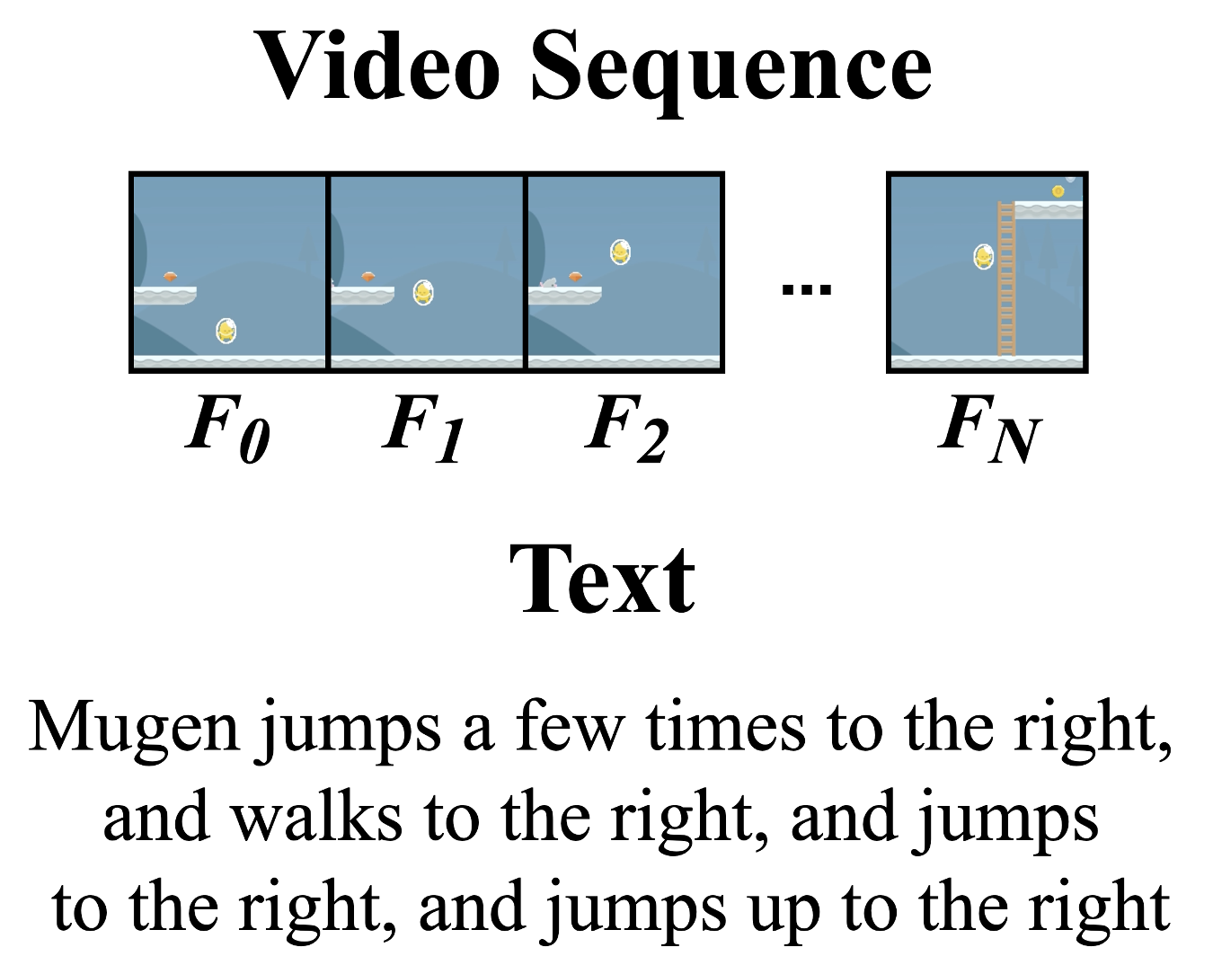
Evaluation Results – Time till Convergence
Input Example

Slide 25
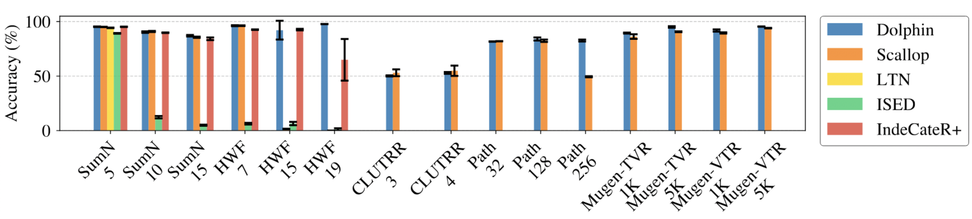
Evaluation Results – Accuracies

Slide 26
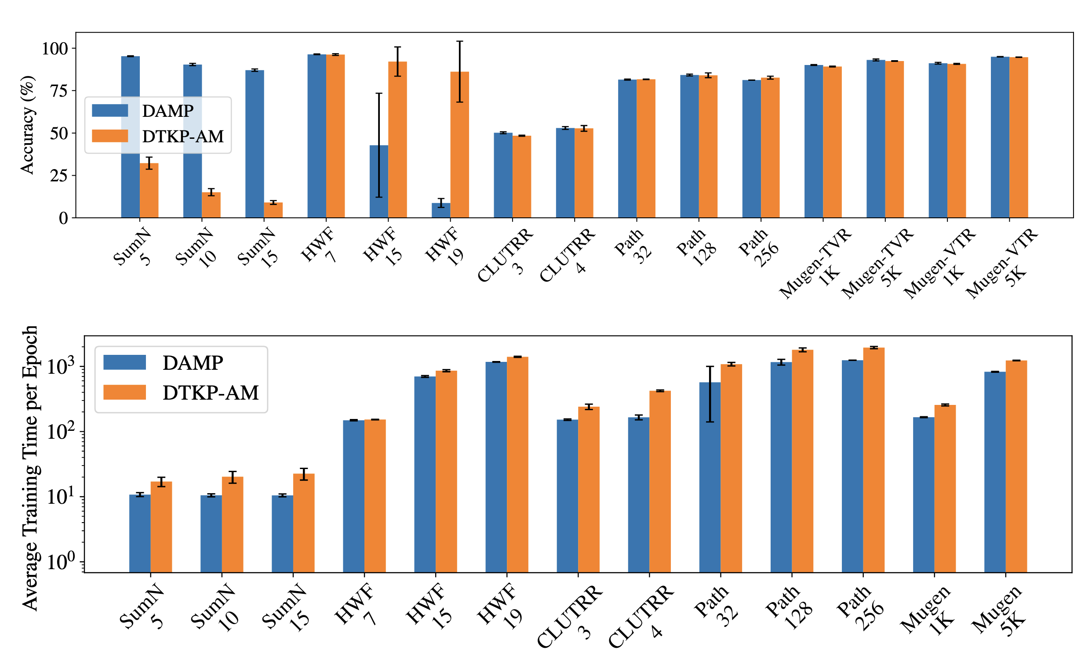
Evaluation Results – DAMP vs DTKP-AM

Slide 27
Conclusions
We propose Dolphin, a Pythonic framework for GPU-driven neurosymbolic programming
Dolphin provides abstractions for writing symbolic programs that involve blackbox functions and recursions
Dolphin scales significantly better than existing neurosymbolic frameworks, training models up to 62x faster without sacrificing accuracy

Slide 28
Neurosymbolic Training
Perception
Reasoning
Solved by Neural Networks…
Solved by Symbolic Programs…
Identifying People in Passages
Detecting Objects in Images
Solving Math Problems
Following Traffic Rules
How can we efficiently train fully differentiable neurosymbolic programs?

Slide 29
How Scallop Works
sum
sum
sum
0
p’’₀₀
0
p’’₁₀
0
p’’_{b0}
1
p’’₀₁
1
p’’₁₁
1
p’’_{b1}
…
…
…
…
…
…
…
19
p’’₀₁₉
19
p’’₁₁₉
19
p’’_{b19}
Scallop
sum(c) :- digit_1(a), digit_2(b), c = a + b
digit_1
digit_2
digit_1
digit_2
digit_1
digit_2
p₀₀
p₀₁
…
p₀₉
p’₀₀
p’₀₁
…
p’₀₉
0
p₀₀
0
p’₀₀
0
p₁₀
0
p’ ₁₀
0
p_{b0}
0
p’ _{b0}
p₁₀
p₁₁
…
p₁₉
p’₁₀
p’₁₁
…
p’₁₉
1
p₀₁
1
p’₀₁
1
p₁₁
1
p’ ₁₁
…
1
p_{b1}
1
p’ _{b1}
…
…
…
…
…
…
…
…
…
…
…
…
…
…
p_{b0}
p_{b1}
…
p_{b9}
p’_{b0}
p’_{b1}
…
p’_{b9}
9
p₀₉
9
p’₀₉
9
p₁₉
9
p’ ₁₉
9
p_{b9}
9
p’ _{b9}

